Slide 1
MAEPF (Multi-Agent Efficient Path Finding)
Software Engineering Lab (CS29202) Project
Arnav Singh
23CS30009

Slide 2
What Is MAEPF?
It is a method to find the most efficient set of paths of more than one bots, given their start and end points and a grid with obstacles.
The method has two major parts to it.
A Star Algortihm
CBS (Constraint Based Search) Tree
A Star Algorithm is a standard algorithm to find the shortest path of one robot on a grid with obstacles, given a distance metric (Manhattan in my case).
CBS is a completely different concept (rather, a research paper) to resolve conflicts in a NP problem. Each node of the CBS Tree Represents a candidate solution with possible conflicts (collision of 2 bots in my case). Each node is split into two child nodes where the first one has a constraint on the path of bot 1 and the other has that on that of bot 2.
My constraints where that the bots can move only horizontally and vertically and they cannot halt until they reach their destination, where they enter a docking hub, maybe underground or inside a neighbouring obstacle.
This has application in fully-automated factories or warehouses where only bots are used to move objects from one place to the other. Eg. Some of Amazon’s warehouses
This might seem to be a standard algorithm, but it’s not one!!!

Slide 3
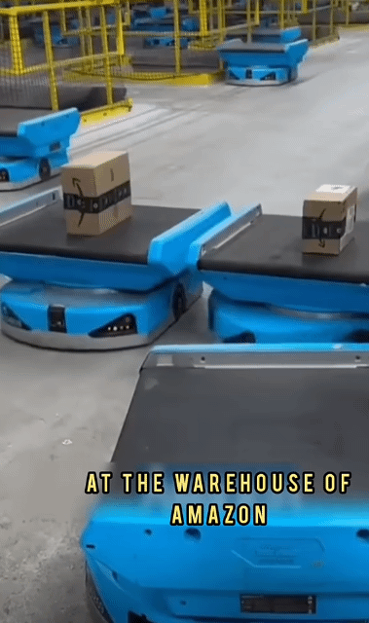
and and and and... (On a LIGHTER note) Amazon can use my software (if I decide to deploy it some day).
*Neither I know whether it’s a fake video, nor I claim it’s ownership. This is just for fun and is not intended to disrespect/insult any individual and/or company.

Slide 4
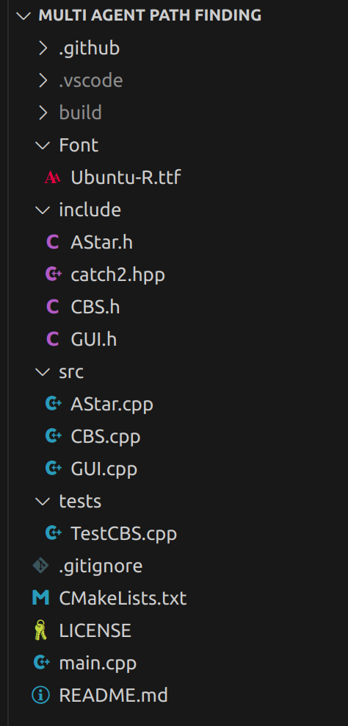
Things Used
Folder Structure
My software is coded fully using C++.
I have used multiple files for better readability and code management.
A Star and CBS code is made using the concept of Object Oriented Programming with everything (problem, conflict, constraint, node, etc.) being a class/structure.
SFML (a library in C++) has been used for making the GUI.
CMakeLists.txt has been used to ease the process of development.
git was used for adding new features and altering the code.

Slide 5
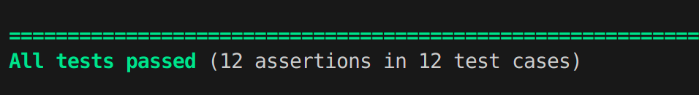
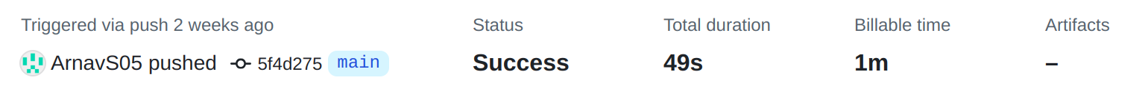
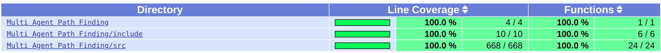
Used Test cases (using catch2.hpp)
Challenges faced:
  Multiple edge cases in the CBS algorithm while resolving conflicts.
  It was my first time with GUI, so I faced some difficulties when I started making the GUI.
Used GitHub’s CI pipeline
Sample Run:
Used lcov for code coverage

Slide 6
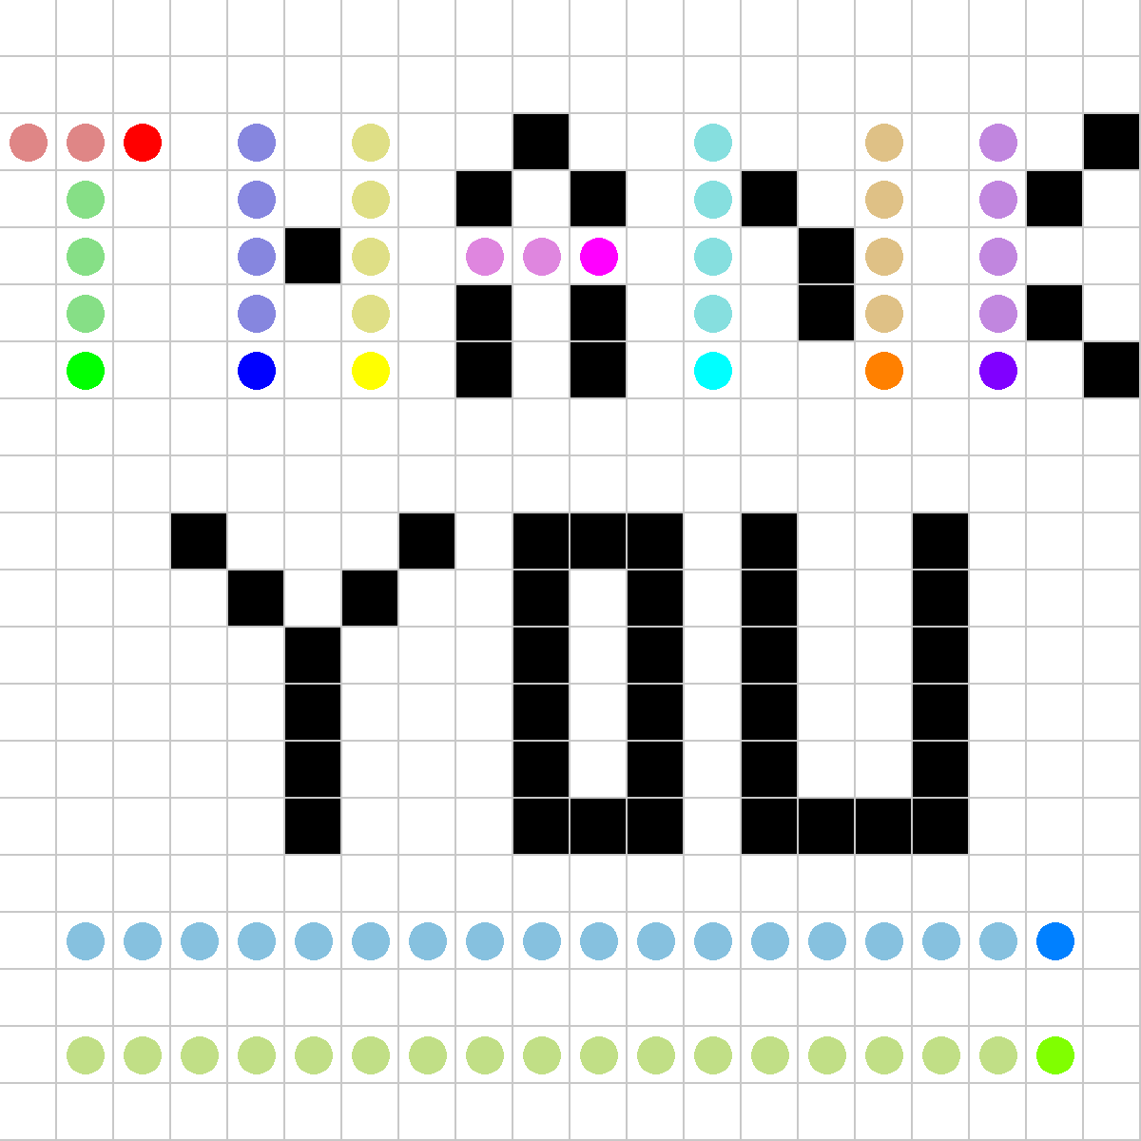
(BTW this is a sample run of my software)

